Slide 1
FINAL YEAR PROJECT PRESENTATION
PROJECT TITLE
Optimization of Plate Fin Heat Exchangers using Grey Wolf Optimization algorithm,
Genetic algorithm and Particle swarm optimization algorithm
NAME: YOUSEF HOSNY ABDELAZIM ELSAYED
MATRIC NUMBER: 17102162/1

Slide 2
Presentation Outline
Introduction
Problem statement
Objectives
Research Gap
Literature Review
Methodology
Results and Discussion
Conclusion

Slide 3
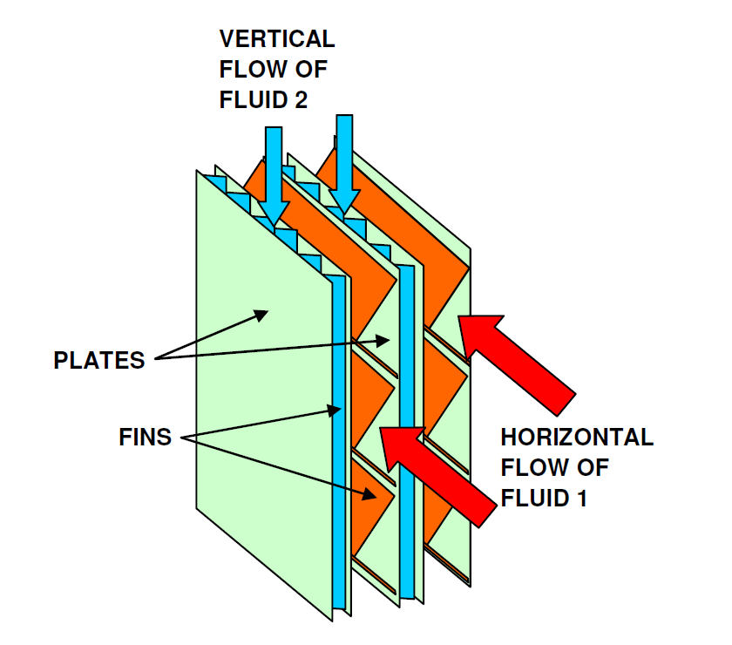
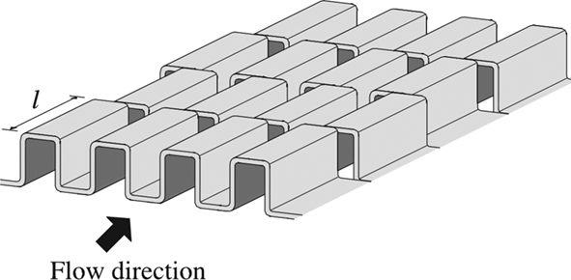



Introduction
SYSTEM
Plate Fin Heat Exchanger
Large heat transfer surface area per unit volume
Small size and Low Weight
High effectiveness
Multiple working fluids
Low energy Consumption
Notes:
Plate Fin Heat Exchangers are compact heat exchangers that consist of multiple layers (up to 1000) and beyond depending on the application
Each layer consists of 2 plates and fins deployed between these 2 plates; these layers are then brazed all together to form the final structure of the plate fin heat exchanger
(because fins are employed on both sides)
(due to a small thickness of the plate)
(because fins interrupt boundary layer growth)
These characteristics make plate fin heat exchangers popular in industries like automotive, aerospace and process plants.

Slide 4
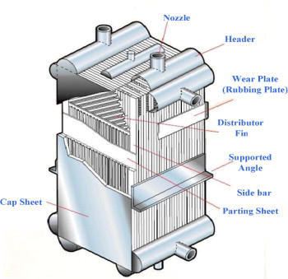
Problem Statement
High effectiveness
Small Size
Energy Saving
Multiple working fluids configuration
High cost
High pressure drop
Notes:
Advantages such as high thermal effectiveness, small size, energy efficient and the ability to configure multiple working fluids make the PFHE very attractive, however a big downside to it is its
high cost due to the complexity involved in the manufacturing process, another downside is the high pressure drop caused by the offset strip fins, therefore we want to optimize the design of the PFHE with the objective of minimizing it’s cost while still achieving a good pressure drop value.

Slide 5
Objectives
Study the design, thermal model and economic model of Plate Fin Heat Exchangers
Minimize the Total Annual Cost and the Pressure Drop of a Plate Fin Heat exchanger by optimizing its design using Evolutionary optimization algorithms
Identify the most efficient Evolutionary Algorithm in optimizing Plate Fin Heat Exchangers
Notes:
Having a preliminary heat exchanger, we want to reduce the total annual cost and the pressure drop of that heat exchanger by optimizing and modifying its design.
Identifying the most efficient evolutionary algorithm will be explained in the next slide

Slide 6
Objectives
OPTIMIZATION METHOD
Artificial Intelligence
Evolutionary Algorithms
Grey Wolf
Optimization
Particle Swarm
Optimization
Genetic Algorithm
Notes:
Evolutionary Algorithms are subbranches of Artificial intelligence, they are nature inspired algorithms that optimize complex design problems where a lot of parameters and constraints are
Involved, there are a lot of different types of evolutionary algorithms but in this problem we are going to use 2 types, the first is Genetic Algorithm
Genetic Algorithm is…
The 2nd type is PSO, PSO is…

Slide 7
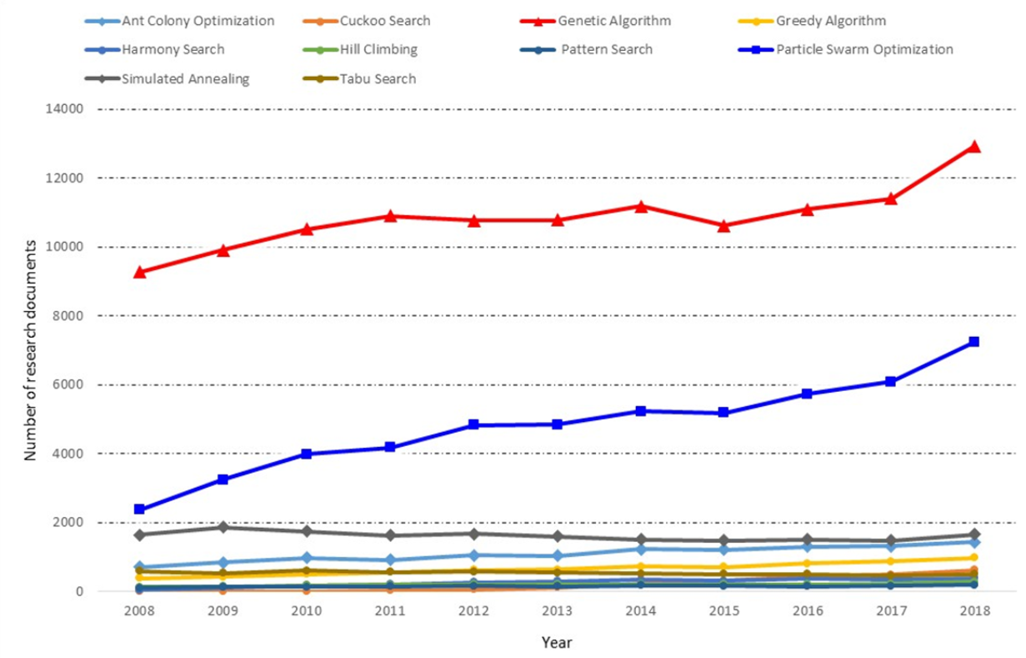
Objectives
OPTIMIZATION METHOD
Accuracy
Computation Time
Popular
Notes:
The reasons behind choosing GA and PSO as the EA to optimize our system is that the solutions they obtain are considered very accurate and close to optimum
Their computation time are low and they are very popular in optimizing design problems.

Slide 8
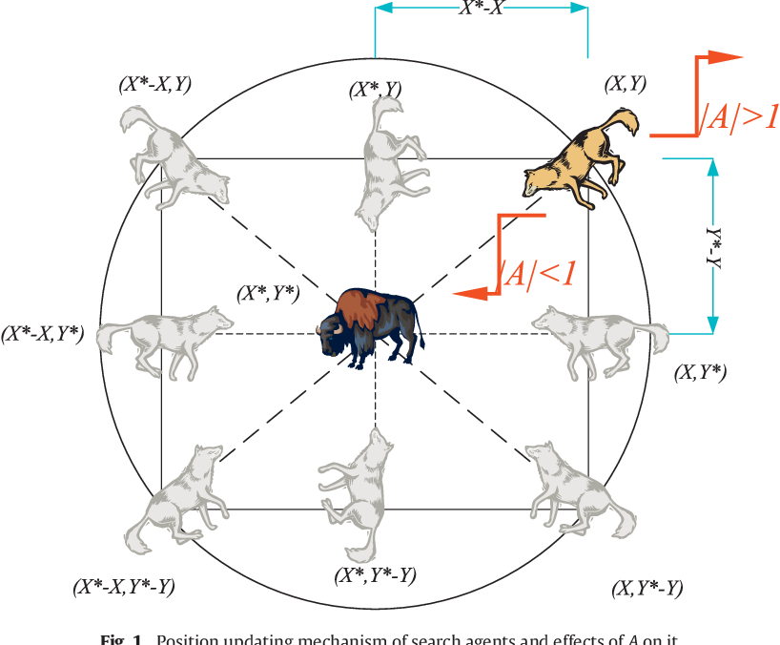
Research Gap
Implementation of Grey Wolf Optimization algorithm
Notes:
Having a preliminary heat exchanger, we want to reduce the total annual cost and the pressure drop of that heat exchanger by optimizing and modifying it’s design.
Identifying the most efficient evolutionary algorithm will be explained in the next slide

Slide 9


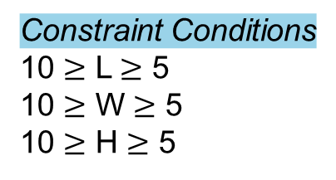
Literature Review
Volume = L x W x H
GENETIC ALGORITHM
Minimization or Maximization
Constraint Conditions
10 $≥$ L $≥$ 5
10 $≥$ W $≥$ 5
10 $≥$ H $≥$ 5
John Holland 1975
Darwin theory of evolution
Selection Operators
Crossover
Operation
L = 5
W = 5
H = 6
V = 150
L = 5
W = 5
H = 10
V = 250
L = 9
W = 6
H = 7
V = 378
L = 6
W = 9
H = 6
V = 324
L = 5
W = 5
H = 10
V = 250
L = 10
W = 10
H = 10
V = 1000
L = 10
W = 9
H = 10
V = 900
L = 6
W = 5
H = 9
V = 270
L = 5
W = 7
H = 8
V = 280
L = 5
W = 5
H = 6
V = 150
L = 8
W = 6
H = 6
V = 288
L = 7
W = 9
H = 10
V = 630
L = 6
W = 5
H = 9
V = 270
L = 5
W = 7
H = 8
V = 280
L = 5
W = 5
H = 6
V = 150
L = 6
W = 6
H = 6
V = 216
L = 5
W = 7
H = 6
V = 210
L = 5
W = 6
H = 6
V = 180
Notes:
Genetic Algorithm was invented by John Holland in 1975, It’s based on the Darwin theory of evolution, survival of the fittest.
The working principle is simple, given an objective function,
GA intiates a set of population that describle solutions of that object function
Every candidate in the population contain his own solution and his own set of parameters that describe that solution.
Then selection operators are applied to that set of population to choose the fittest candidates and eliminate the un fit candidates
Then the fit candidates are combined in a mating pool where reproduction operators are applied to them to produce offspring that have similar characteristics and solutions to the parents
The offspring the replaces the unfit candidates thus producing a set of population that is more fit and this process is on loop until the optimal solution of the objective function is found.

Slide 10
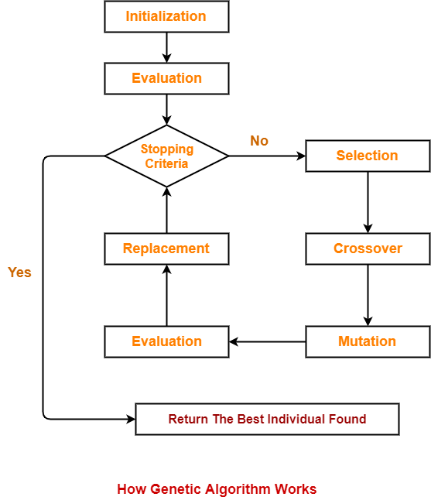
Literature Review
GENETIC ALGORITHM
John Holland 1975
Darwin theory of evolution
Notes:
Genetic Algorithm was invented by Kennedy and Eberhard in 1995, It’s based on the Study of social behavior of birds in a swarm.
The working principle is simple, given an objective function,
PSO intiates a set of particles that describe solutions of that object function
Every particle in the swarm contains his own solution and his own set of parameters that describe that solution.
After that the fittest particle is identified and selected as a global best.
Following that, the particles starts to accelerate in the direction of the fittest candidate through this mechanism
Every particle has its own position and velocity vector, it also has it’s personal best location so far.
There is a vector from the current position to the personal best position
There is a vector from the current position to the personal best position
Now we have a total of 3 vectors, when the particle moves it will move parallel to all 3 vectors like this

Slide 11
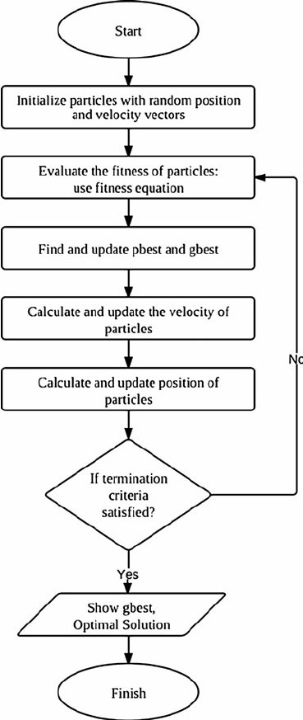
Literature Review
PARTICLE SWARM OPTIMIZATION
Kennedy and Eberhard 1995
Social behavior of bird in a swarm
Notes:
Genetic Algorithm was invented by Kennedy and Eberhard in 1995, It’s based on the Study of social behavior of birds in a swarm.
The working principle is simple, given an objective function,
PSO intiates a set of particles that describe solutions of that object function
Every particle in the swarm contains his own solution and his own set of parameters that describe that solution.
After that the fittest particle is identified and selected as a global best.
Following that, the particles starts to accelerate in the direction of the fittest candidate through this mechanism
Every particle has its own position and velocity vector, it also has it’s personal best location so far.
There is a vector from the current position to the personal best position
There is a vector from the current position to the personal best position
Now we have a total of 3 vectors, when the particle moves it will move parallel to all 3 vectors like this

Slide 12
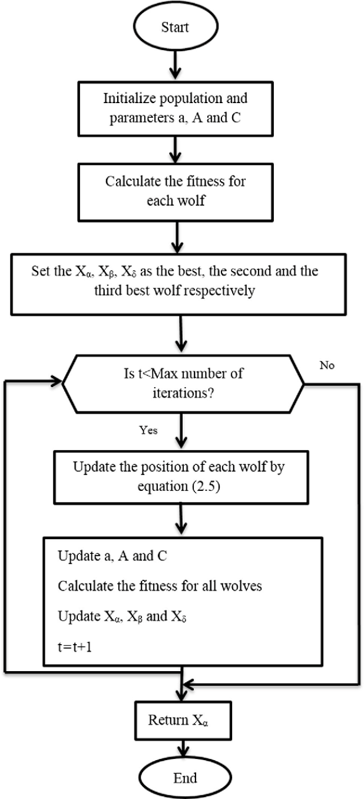
Literature Review
GREY WOLF OPTIMIZATION ALGORITHM
Mirjaliali and Lewis 2014
Hunting technique of Grey Wolves
Notes:
Genetic Algorithm was invented by Kennedy and Eberhard in 1995, It’s based on the Study of social behavior of birds in a swarm.
The working principle is simple, given an objective function,
PSO intiates a set of particles that describe solutions of that object function
Every particle in the swarm contains his own solution and his own set of parameters that describe that solution.
After that the fittest particle is identified and selected as a global best.
Following that, the particles starts to accelerate in the direction of the fittest candidate through this mechanism
Every particle has its own position and velocity vector, it also has it’s personal best location so far.
There is a vector from the current position to the personal best position
There is a vector from the current position to the personal best position
Now we have a total of 3 vectors, when the particle moves it will move parallel to all 3 vectors like this

Slide 13
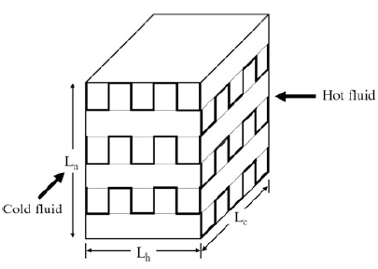
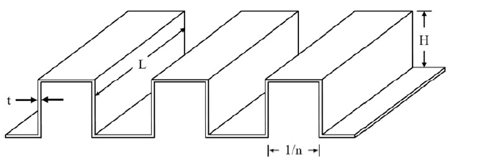
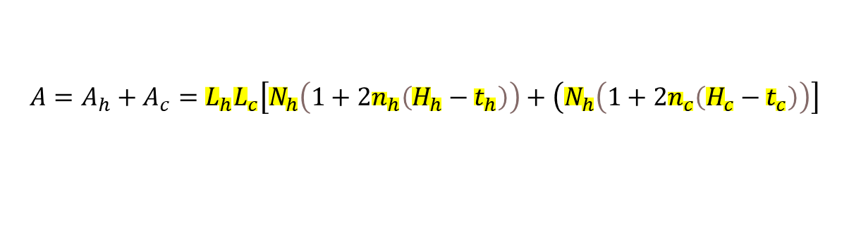
Literature Review
THERMAL MODEL
$$A=A_{h}+A_{c}=L_{h}L_{c}\left[N_{h}\left(1+2n_{h}\left(H_{h}−t_{h}\right)\right)+\left(N_{h}\left(1+2n_{c}\left(H_{c}−t_{c}\right)\right)\right]\right.$$
$$A_{ff,h}=\left(H_{h}−t_{h}\right)\left(1−n_{h}t_{h}\right)L_{c}N_{h}$$
$$A_{ff,c}=\left(H_{c}−t_{c}\right)\left(1−n_{c}t_{c}\right)L_{h}N_{c}$$
Patel, V. K., Savsani, V. J., & Tawhid, M. A. (2019). Thermal System Optimization A Population-Based Metaheuristic Approach. Cham: Springer International Publishing.
Notes:
A is the total heat transfer surface area
Aff free flow area of the hot side and cold side respectively

Slide 14
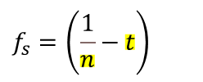




Literature Review
THERMAL MODEL
Heat coefficient → $h=jGC_{p}{\left(pr\right)}^{−0.667}$
Prandtl number → $pr=\frac{μC_{p}}{k}$
Mass flux velocity → $G=\frac{m}{A_{ff}}$
$$j={\left(0.6522 {\left(Re\right)}^{−0.5403}{\left(α\right)}^{−0.1541}{\left(δ\right)}^{0.1499}{\left(γ\right)}^{−0.0678}\left[1+5.269∗{10}^{−5}{\left(Re\right)}^{1.34}{\left(α\right)}^{0.504}{\left(δ\right)}^{0.456}{\left(γ\right)}^{−1.055}\right]\right)}^{0.1}$$
$$Re=\frac{Gd_{h}}{μ}$$
$$α=\frac{f_{s}}{H−t}$$
$$δ=\frac{t}{l_{f}}$$
$$γ=\frac{t}{f_{s}}$$
$$f_{s}=\left(\frac{1}{n}−t\right)$$
Patel, V. K., Savsani, V. J., & Tawhid, M. A. (2019). Thermal System Optimization A Population-Based Metaheuristic Approach. Cham: Springer International Publishing.
Notes:
Lf is the fin offset length
Cp is the specific heat of the fluid
μ is the viscosity
k is the thermal conductivity
Fs is the fin spacing

Slide 15

Literature Review
THERMAL MODEL
Hydraulic Diameter → $d_{h}=\frac{4f_{s}l_{f}\left(H−t\right)}{2\left(f_{s}l_{f}+\left(H−t\right)l_{f}+\left(H−t\right)t\right)+tf_{s}}$
Pressure drop (hot side) → $∆P_{h}=\frac{2f_{h}L_{h}{G_{h}}^{2}}{ρ_{h}d_{h,h}}$
Pressure drop (cold side) → $∆P_{c}=\frac{2f_{c}L_{c}{G_{c}}^{2}}{ρ_{c}d_{h,c}}$
$$f={\left(9.6243 {\left(Re\right)}^{−0.7422}{\left(α\right)}^{−0.1856}{\left(δ\right)}^{0.3053}{\left(γ\right)}^{−0.2659}\left[1+7.669∗{10}^{−8}{\left(Re\right)}^{4.429}{\left(α\right)}^{0.920}{\left(δ\right)}^{3.767}{\left(γ\right)}^{0.236}\right]\right)}^{0.1}$$
Patel, V. K., Savsani, V. J., & Tawhid, M. A. (2019). Thermal System Optimization A Population-Based Metaheuristic Approach. Cham: Springer International Publishing.

Slide 16

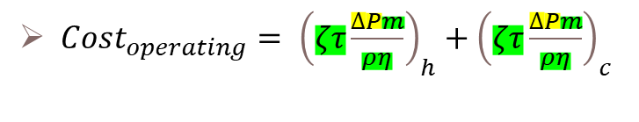
Literature Review
ECONOMIC MODEL
${Cost}_{total annual}={Cost}_{capital}+{Cost}_{operating}$
${Cost}_{capital}=A_{cf}C_{A}A^{n_{1}}$
$A_{cf}$ is the annual coefficient factor
$C_{A}$ is the cost per unit surface area
$A$ is the total heat transfer surface area
$n_{1}$ is the exponent of nonlinear increase with area increase
$ζ$ is the electricity price
$τ$ is the operating hours per year
$ρ$ is the density of the fluid
$η$ is the compressor efficiency
${Cost}_{operating}= {\left(ζτ\frac{∆Pm}{ρη}\right)}_{h}+{\left(ζτ\frac{∆Pm}{ρη}\right)}_{c}$
Patel, V. K., Savsani, V. J., & Tawhid, M. A. (2019). Thermal System Optimization A Population-Based Metaheuristic Approach. Cham: Springer International Publishing.
Notes:
$A_{cf}$ is the annual coefficient factor
$C_{A}$ is the cost per unit surface area
$A$ is the t
$n_{1}$ is the exponent of nonlinear increase with area increase
$ζ$ zeta is the electricity price
$τ$ is the operating hours per year
$ρ$ is the density of the fluid
$η$ is the compressor efficiency

Slide 17
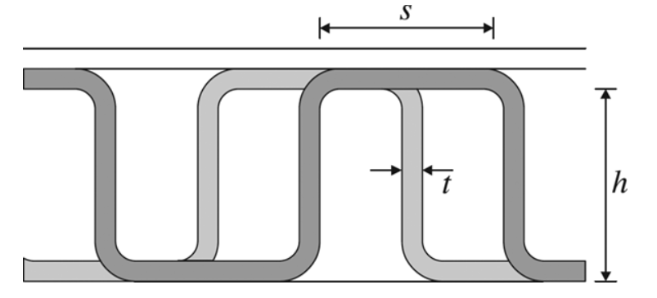
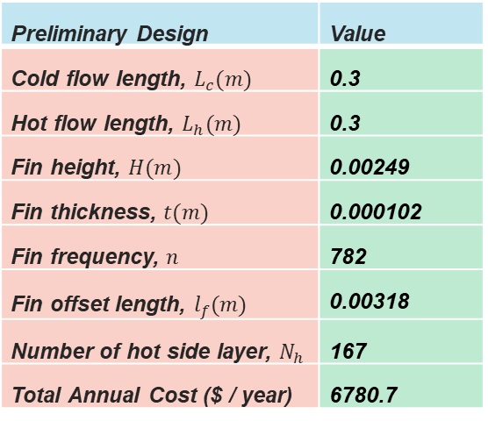
Methodology
CASE STUDY
Preliminary Plate Fin Heat Exchanger
Preliminary Design | Value
Cold flow length, $L_{c}(m)$ | 0.3
Hot flow length, $L_{h}(m)$ | 0.3
Fin height, $H(m)$ | 0.00249
Fin thickness, $t(m)$ | 0.000102
Fin frequency, $n$ | 782
Fin offset length, $l_{f}(m)$ | 0.00318
Number of hot side layer, $N_{h}$ | 167
Total Annual Cost ($ / year) | 6780.7
Patel, V. K., Savsani, V. J., & Tawhid, M. A. (2019). Thermal System Optimization A Population-Based Metaheuristic Approach. Cham: Springer International Publishing.
Notes:
These are all constant and they are considered our input parameters.

Slide 18
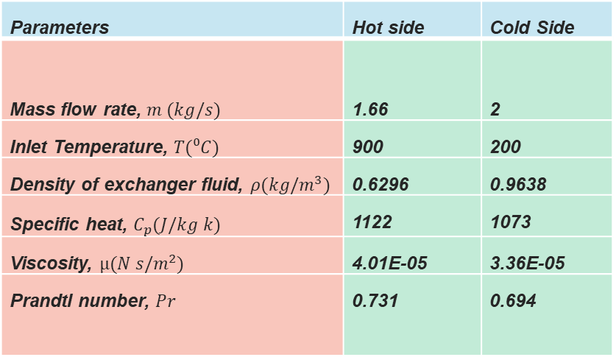
Methodology
CASE STUDY
Operating Conditions (Input)
Parameters | Hot side | Cold Side
Mass flow rate, $m (kg/s)$ | 1.66 | 2
Inlet Temperature, $T(⁰C)$ | 900 | 200
Density of exchanger fluid, $ρ(kg/m^{3})$ | 0.6296 | 0.9638
Specific heat, $C_{p}(J/kg k)$ | 1122 | 1073
Viscosity, $µ(N s/m^{2})$ | 4.01E-05 | 3.36E-05
Prandtl number, $Pr$ | 0.731 | 0.694
Patel, V. K., Savsani, V. J., & Tawhid, M. A. (2019). Thermal System Optimization A Population-Based Metaheuristic Approach. Cham: Springer International Publishing.
Notes:
These are all constant and they are considered our input parameters.

Slide 19
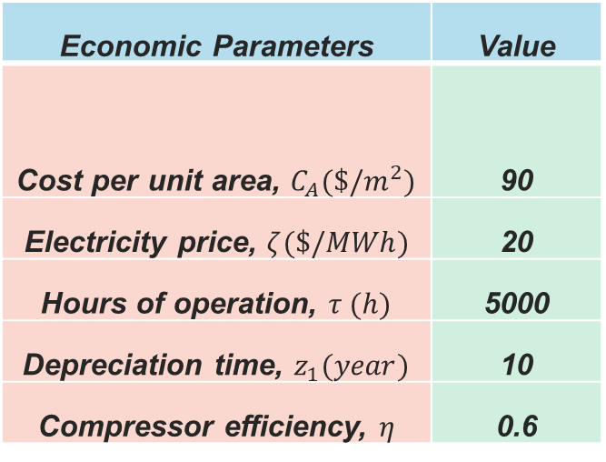
Methodology
CASE STUDY
Economic Parameters (Input)
Economic Parameters | Value
Cost per unit area, $C_{A}(\$/m^{2})$ | 90
Electricity price, $ζ(\$/MWh)$ | 20
Hours of operation, $τ (h)$ | 5000
Depreciation time, $z_{1}(year)$ | 10
Compressor efficiency, $η$ | 0.6
Patel, V. K., Savsani, V. J., & Tawhid, M. A. (2019). Thermal System Optimization A Population-Based Metaheuristic Approach. Cham: Springer International Publishing.

Slide 20
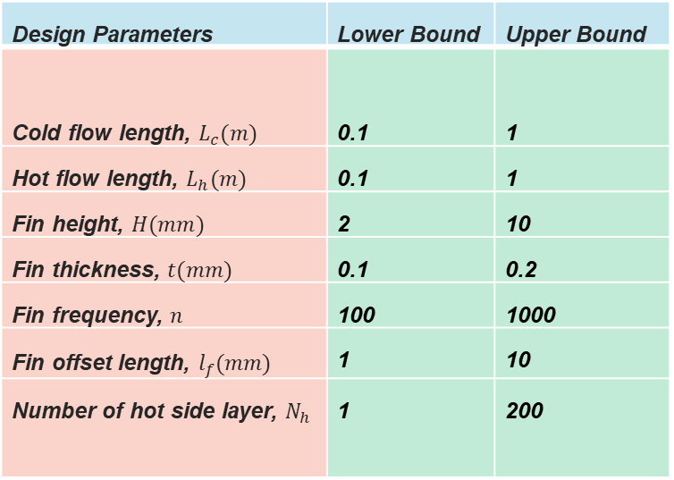
Methodology
CASE STUDY
Design Parameters (Output)
Design Parameters | Lower Bound | Upper Bound
Cold flow length, $L_{c}(m)$ | 0.1 | 1
Hot flow length, $L_{h}(m)$ | 0.1 | 1
Fin height, $H(mm)$ | 2 | 10
Fin thickness, $t(mm)$ | 0.1 | 0.2
Fin frequency, $n$ | 100 | 1000
Fin offset length, $l_{f}(mm)$ | 1 | 10
Number of hot side layer, $N_{h}$ | 1 | 200
Notes:
we will run our algorithms to find the values of these parameters between the lower and upper bounds that will minimize our TAC

Slide 21

Methodology
CONSTRAINTS
$$0.134< α<0.997$$
$$0.012< δ<0.048$$
$120<Re<{10}^{4}$
$0.041< γ<0.121$
$$ΔP_{h}≤9.5 kPa$$
$$ΔP_{c}≤8 kPa$$
$$Heat Duty (Q)≥1069.8W$$
Flow Characteristics
Pressure Drop
Heat Duty

Slide 22
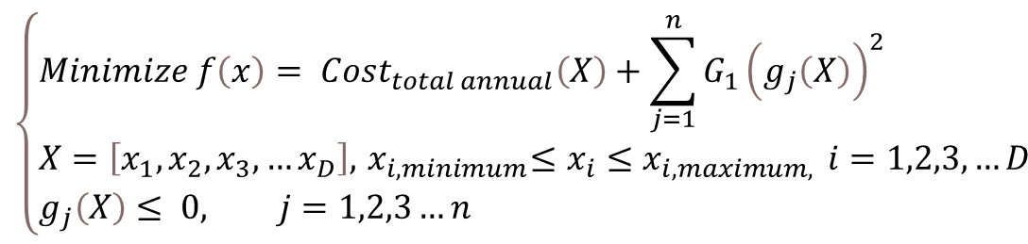
Methodology
OBJECTIVE FUNCTION
$$\left\{\begin{aligned}&Minimize f\left(x\right)= {Cost}_{total annual}\left(X\right)+\sum_{j=1}^{n}{G_{1}{\left(g_{j}\left(X\right)\right)}^{2}} \\ &X=\left[x_{1},x_{2},x_{3},…x_{D}\right],{ x}_{i,minimum}≤x_{i}≤x_{i,maximum, } i=1,2,3,…D \\ &g_{j}\left(X\right)≤ 0, j=1,2,3…n\end{aligned}\right.$$

Slide 23


Methodology
Objective Function (Total Annual Cost Equation)
FINAL EQUATION
((Acf * 90 * ((x(1)*x(2)*x(7)*(1+2*x(5)*(x(3)-x(4)))) + (x(1)*x(2)*x(7)*(1+2*x(5)*(x(3)-x(4)))))^0.6)) + (((tao*elec*(((2)*( (9.6243*(((1.66 / ((x(3) - x(4))*(1 - x(5)*x(4))*x(2)*x(7))) * (((4)*(((1 / x(5) ) - x(4)))*(x(6))*(x(3) - x(4)))/(2*((((1 / x(5) ) - x(4))*x(6))+(x(3)-x(4))*x(6)+(x(3) - x(4))*x(4))+x(4)*((1 / x(5) ) - x(4)))))/4.01e-05)^-0.7422*(((1 / x(5) ) - x(4)) / (x(3) - x(4)))^-0.1856*( x(4) / x(6))^0.3053*( x(4) / ((1 / x(5) ) - x(4)))^-0.2659)*(1+7.669e-08*(((1.66 / ((x(3) - x(4))*(1 - x(5)*x(4))*x(2)*x(7))) * (((4)*(((1 / x(5) ) - x(4)))*(x(6))*(x(3) - x(4)))/(2*((((1 / x(5) ) - x(4))*x(6))+(x(3)-x(4))*x(6)+(x(3) - x(4))*x(4))+x(4)*((1 / x(5) ) - x(4)))))/4.01e-05)^4.429*(((1 / x(5) ) - x(4)) / (x(3) - x(4)))^0.920*( x(4) / x(6))^3.767*( x(4) / ((1 / x(5) ) - x(4)))^0.236)^0.1)*x(1)*(( 1.66 / ((x(3) - x(4))*(1 - x(5)*x(4))*x(2)*x(7)))^2))/((0.6296)*( ((4)*(((1 / x(5) ) - x(4)))*(x(6))*(x(3) - x(4)))/(2*((((1 / x(5) ) - x(4))*x(6))+(x(3)-x(4))*x(6)+(x(3) - x(4))*x(4))+x(4)*((1 / x(5) ) - x(4)))))*10e-4)*mh)/(0.6*0.6296))+((tao*elec*(((2)*( (9.6243*(((2 / ((x(3) - x(4))*(1 - x(5)*x(4))*x(1)*(x(7)+1))) * (((4)*(((1 / x(5) ) - x(4)))*(x(6))*(x(3) - x(4)))/(2*((((1 / x(5) ) - x(4))*x(6))+(x(3)-x(4))*x(6)+(x(3) - x(4))*x(4))+x(4)*((1 / x(5) ) - x(4))))) / 3.36e-05)^-0.7422*(((1 / x(5) ) - x(4)) / (x(3) - x(4)))^-0.1856*( x(4) / x(6))^0.3053*( x(4) / ((1 / x(5) ) - x(4)))^-0.2659)*(1+7.669e-08*(((2 / ((x(3) - x(4))*(1 - x(5)*x(4))*x(1)*(x(7)+1))) * (((4)*(((1 / x(5) ) - x(4)))*(x(6))*(x(3) - x(4)))/(2*((((1 / x(5) ) - x(4))*x(6))+(x(3)-x(4))*x(6)+(x(3) - x(4))*x(4))+x(4)*((1 / x(5) ) - x(4))))) / 3.36e-05)^4.429*(((1 / x(5) ) - x(4)) / (x(3) - x(4)))^0.920*( x(4) / x(6))^3.767*( x(4) / ((1 / x(5) ) - x(4)))^0.236)^0.1)*x(2)*(( 2 / ((x(3) - x(4))*(1 - x(5)*x(4))*x(1)*(x(7)+1)))^2))/((0.9638)*( ((4)*(((1 / x(5) ) - x(4)))*(x(6))*(x(3) - x(4)))/(2*((((1 / x(5) ) - x(4))*x(6))+(x(3)-x(4))*x(6)+(x(3) - x(4))*x(4))+x(4)*((1 / x(5) ) - x(4)))))*10e-4)*mc)/(0.6*0.9638)));
x(1)= $L_{c}(m)$
x(2)= $L_{h}(m)$
x(3)= $H(m)$
x(4)= $t(m)$
x(5)= $n$
x(6)= $l_{f}(m)$
x(7)= $N_{h}$
Notes:
We will use matlab to write the code of the algorithm, the steps of the code can be described by the following
First is to input all the parameters that describe the PFHE and the algorithm, like operating conditions, economic parameters and population size etc..
Second is to initiate a random population in the solution space
Third is to obtain the solutions that every candidate is carrying in his memory
Fourth is the selection step, In this step, the roulette wheel mechanism will be used to select the fittest candidates of the population, while eliminating the unfit candidates, candidates with better solutions have more entries in the roulette wheel thus they have more chances of being selected.
Fifth is the cross over step where the selected candidates will do a cross over to produce offsprings that will replace the eliminated candidates
Sixth step is saving the fittest candidates so they will not be included in the selection procedure and cross over procedure unless candidates with better solutions are found
Steps 3 to Step 7 are on loop until the optimal solution is found or the algorithm is terminated.

Slide 24
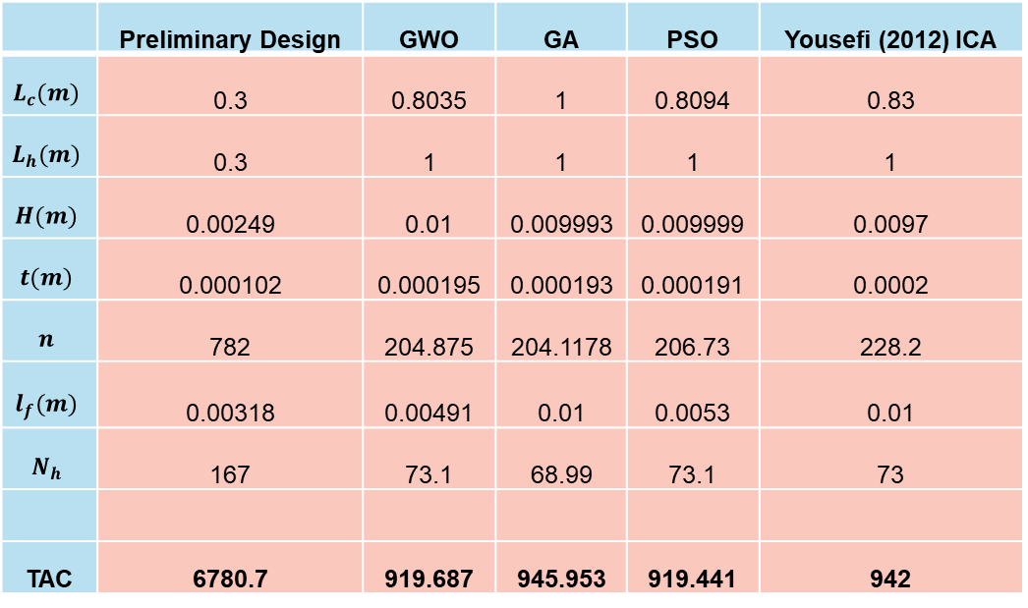
Results and Discussion
TOTAL ANNUAL COST
 | Preliminary Design | GWO | GA | PSO | Yousefi (2012) ICA
$$L_{c}(m)$$ | 0.3 | 0.8035 | 1 | 0.8094 | 0.83
$$L_{h}(m)$$ | 0.3 | 1 | 1 | 1 | 1
$$H(m)$$ | 0.00249 | 0.01 | 0.009993 | 0.009999 | 0.0097
$$t(m)$$ | 0.000102 | 0.000195 | 0.000193 | 0.000191 | 0.0002
$$n$$ | 782 | 204.875 | 204.1178 | 206.73 | 228.2
$$l_{f}(m)$$ | 0.00318 | 0.00491 | 0.01 | 0.0053 | 0.01
$$N_{h}$$ | 167 | 73.1 | 68.99 | 73.1 | 73
TAC | 6780.7 | 919.687 | 945.953 | 919.441 | 942
Preliminary TAC = 6780.7
New TAC = 919.441
86% REDUCTION!

Slide 25

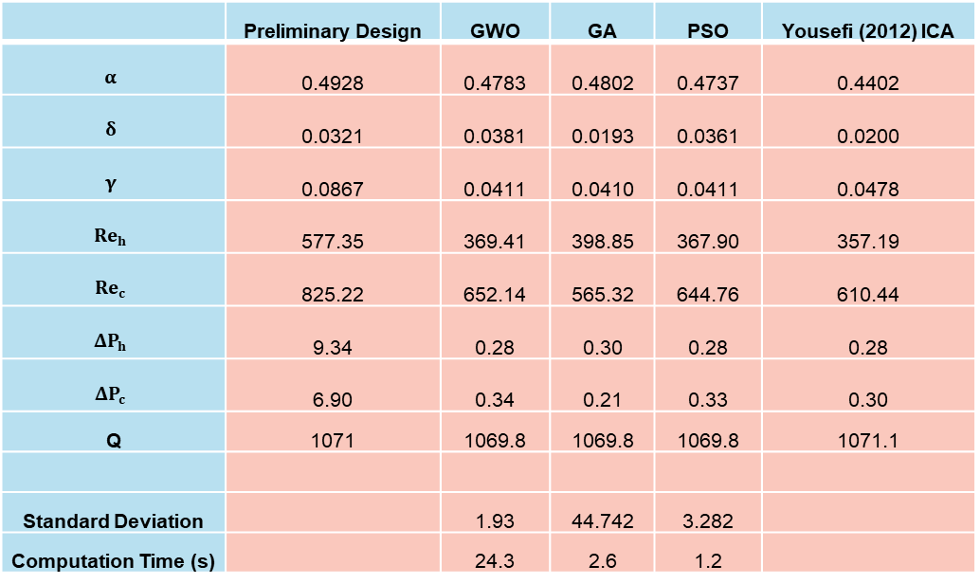
Results and Discussion
CONSTRAINT CONDITIONS AND PERFORMANCE
$$0.134< α<0.997$$
$$0.012< δ<0.048$$
$0.041< γ<0.121$
$120<Re<{10}^{4}$
$$ΔP_{h}≤9.5 kPa$$
$$ΔP_{c}≤8 kPa$$
$$Heat Duty (Q)≥1069.8W$$
 | Preliminary Design | GWO | GA | PSO | Yousefi (2012) ICA
$$α$$ | 0.4928 | 0.4783 | 0.4802 | 0.4737 | 0.4402
$$δ$$ | 0.0321 | 0.0381 | 0.0193 | 0.0361 | 0.0200
$$γ$$ | 0.0867 | 0.0411 | 0.0410 | 0.0411 | 0.0478
$${Re}_{h}$$ | 577.35 | 369.41 | 398.85 | 367.90 | 357.19
$${Re}_{c}$$ | 825.22 | 652.14 | 565.32 | 644.76 | 610.44
$$ΔP_{h}$$ | 9.34 | 0.28 | 0.30 | 0.28 | 0.28
$$ΔP_{c}$$ | 6.90 | 0.34 | 0.21 | 0.33 | 0.30
Q | 1071 | 1069.8 | 1069.8 | 1069.8 | 1071.1
Standard Deviation |  | 1.93 | 44.742 | 3.282
Computation Time (s) |  | 24.3 | 2.6 | 1.2

Slide 26
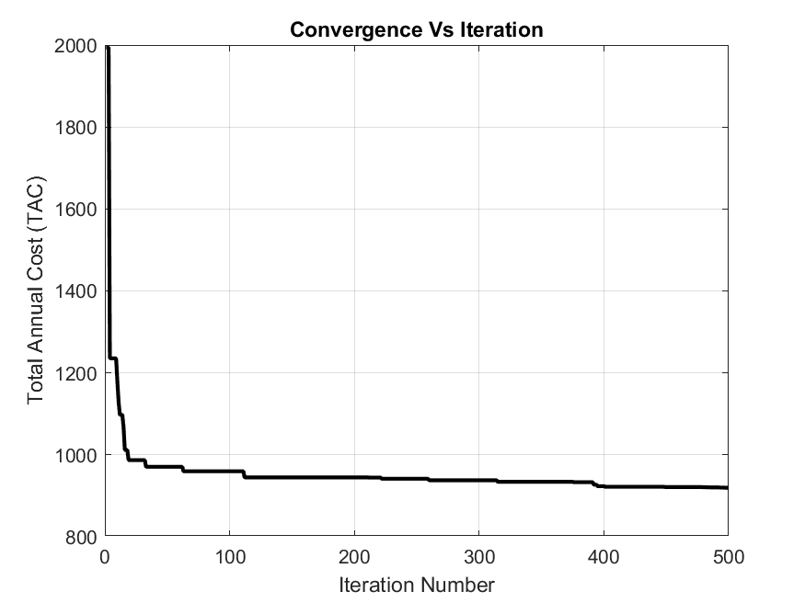
Results and Discussion
GREY WOLF OPTIMIZATION ALGORITHM CONVERGENCE GRAPH
TAC = 919.687 $ / year
Notes:
Here are the results obtained in this project compared with the results obtained by savsani, patel and tawhid, etc…
Because of the time constraint, we were not able to optimize the algorithm properties, to produce better optimal solutions, however by next semester, these properties will be investigated
and new solutions will be obtained.

Slide 27
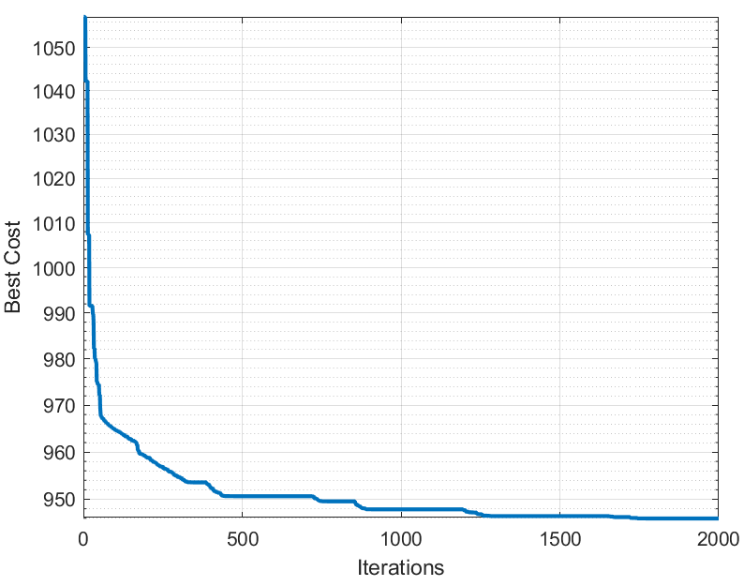
Results and Discussion
GENETIC ALGORITHM CONVERGENCE GRAPH
TAC = 945.953 $ / year
Notes:
Here are the results obtained in this project compared with the results obtained by savsani, patel and tawhid, etc…
Because of the time constraint, we were not able to optimize the algorithm properties, to produce better optimal solutions, however by next semester, these properties will be investigated
and new solutions will be obtained.

Slide 28
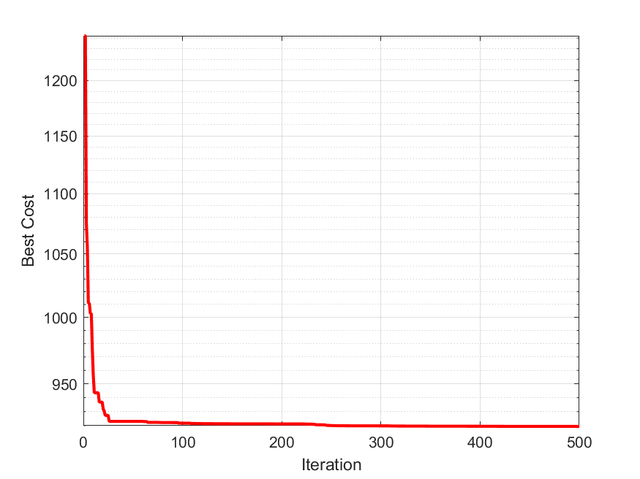
Results and Discussion
PARTICLE SWARM OPTIMIZATION ALGORITHM CONVERGENCE GRAPH
TAC = 919.441 $ / year
Notes:
Here are the results obtained in this project compared with the results obtained by savsani, patel and tawhid, etc…
Because of the time constraint, we were not able to optimize the algorithm properties, to produce better optimal solutions, however by next semester, these properties will be investigated
and new solutions will be obtained.

Slide 29
Conclusion
Thermal and Economic model of the PFHE were investigated
Optimization of the PFHE using GWO, GA and PSO
Algorithm performances in terms of best solution, stability and computation time
Advantages and Disadvantages of GWO
Further Investigation
Notes:
Optimization of the PFHE using GA was conducted this semester and optimal design parameters were obtained
However due to the time constraint the properties of the algorithm were not examined therefore by next semester it will be examined and better solutions will be obtained.
Due to the time constraint as well the development of PSO code in matlab wasn’t possible this semester, however by next semester the pso code will be developed
Finally, the results obtained by PSO and GA will be compared among each other and compared with results obtained by past researchers using different algorithms, thus we will achieve our
objectives of optimizing the PFHE and determining the most efficient algorithm in solving thermal systems optimization problems.

